Slide 1
Programming Practice
*
**
***
****
*****
******
*******
Shape making with console print:
If you google “ASCII art” or “text art”, you can find more nice shapes/pictures
FizzBuzz:
The program print all numbers from 1 to 100.
For those numbers divisible by 3, print ‘Fizz’ instead. For those numbers divisible by 5, print ‘Buzz’ instead. For those numbers divisible by both 3 and 5, print ‘FizzBuzz’ instead.
Chess board:
Normal chess board is 8x8 and each cell is black or white. We use empty space as white, use ‘#’ as black, to print the chess board.
Change the program to allow for any size besides 8.
# # # #
# # # #
# # # #
# # # #
# # # #
# # # #
# # # #
# # # #

Slide 2

Programming practice
Fibonacci series:
make a program to generate Fibonacci series. (the next number is the sum of previous two numbers)
Start from 0, 1, after output 20 numbers then end.
3 digits Narcissistic number:
3 digits integer, which equals the sum of each digit cubed

Slide 3
Programming practice
Find prime number:
Find all prime numbers which <100.
Prime number: only 1 and itself as factor, no other factor.
Method 1: for each number, check if it has more factors other than 1 and itself
Method 2: sieve of Eratosthenes
list all numbers from 2 to 100, start delete those number which are multiples of 2, multiples of 3, etc. each time select one new prime number you find and delete its multiples, when you reach to 100, you have removed all non-prime numbers, and left all prime numbers.

Slide 4
Programming practice
3*n+1 sequence:
Start with any number, call it n
Rule for next item:
if n is even, divide it by 2.
If n not even, multiply it by 3 and then plus 1
Continue until the item becomes 1
Counting digits:
Given any number n (integer number)
Count how many digits it have

Slide 5
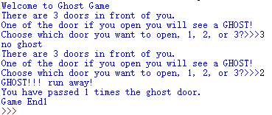
Ghost game
Randomly put a ghost behind one of 3 doors. Ask the user to choose one of the 3 doors to pass. If the ghost is behind the chosen door, game stops
After game stop shows to user how many times has passed the door with no ghost.

Slide 6
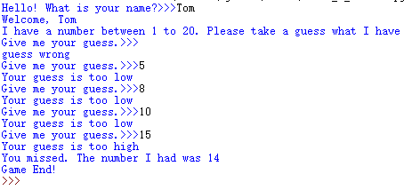
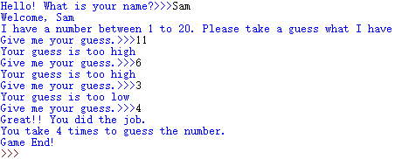
Guess the number
the program will randomly generate a number between 1 to 20, and ask the user to guess it.
If the user get it, the program stops and congrats the user. If not, prompt if user guess is high, or low.
After repeat guess it for 5 times if still not get it, the program stops. It reminds the user have missed this time and show to the user the number it holds.
Module in python is a collection of functions / programms for other person to use. You can create your own modules, one file is one module.
Name space decide how the program looks for different names. Module name random.randint()

Slide 7
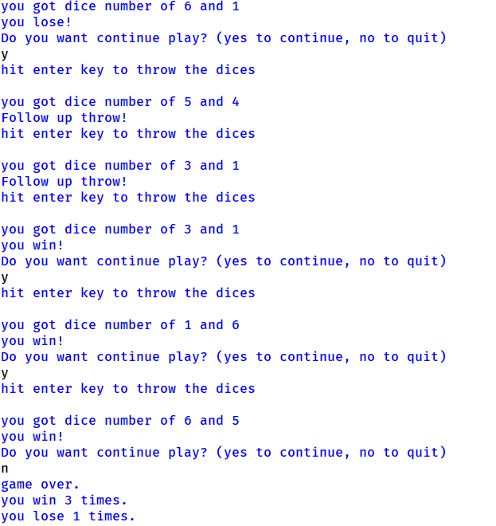
Dice game
The player throws a pair of dice. The sum of the two top faces is what matters so a 1 and a 3 is the same as 2 and 2.
The sum of two 6-sided dice can be any number from 2 to 12.
If the player throws a 7 or 11 on the first throw, the player wins. If the player throws a 2, 3, or 12, the player loses.
For any other result (4, 5, 6, 8, 9, 10), this result is recorded as what is called the player’s point and a follow-up throw is required.
On follow-up throws, a throw of 7 loses and a throw of the player’s point wins. For anything else, the game continues with the follow-up throw rules.

